Slide 1
WAVEGUIDE HEATING PROBLEM

Slide 2
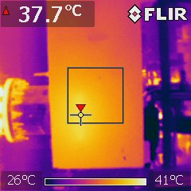
HEATING PROBLEM IN WAVEGUIDE TRANSITION
RF station 4
RF station 3

